Slide 1
Swarm Robotics
A Master Slave Approach

Slide 2
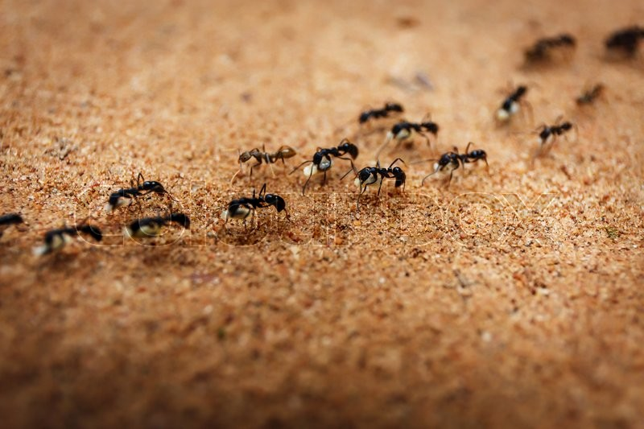
Swarm Intelligence

Slide 3

Master Slave Approach

Slide 4
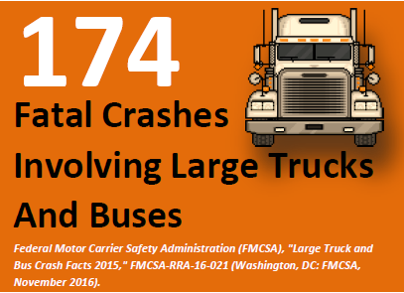

Slide 5
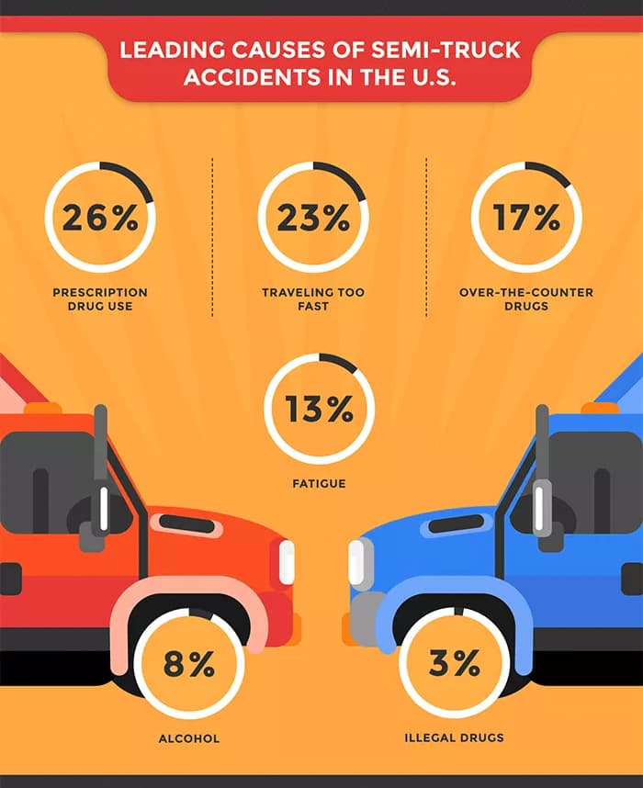

Slide 6
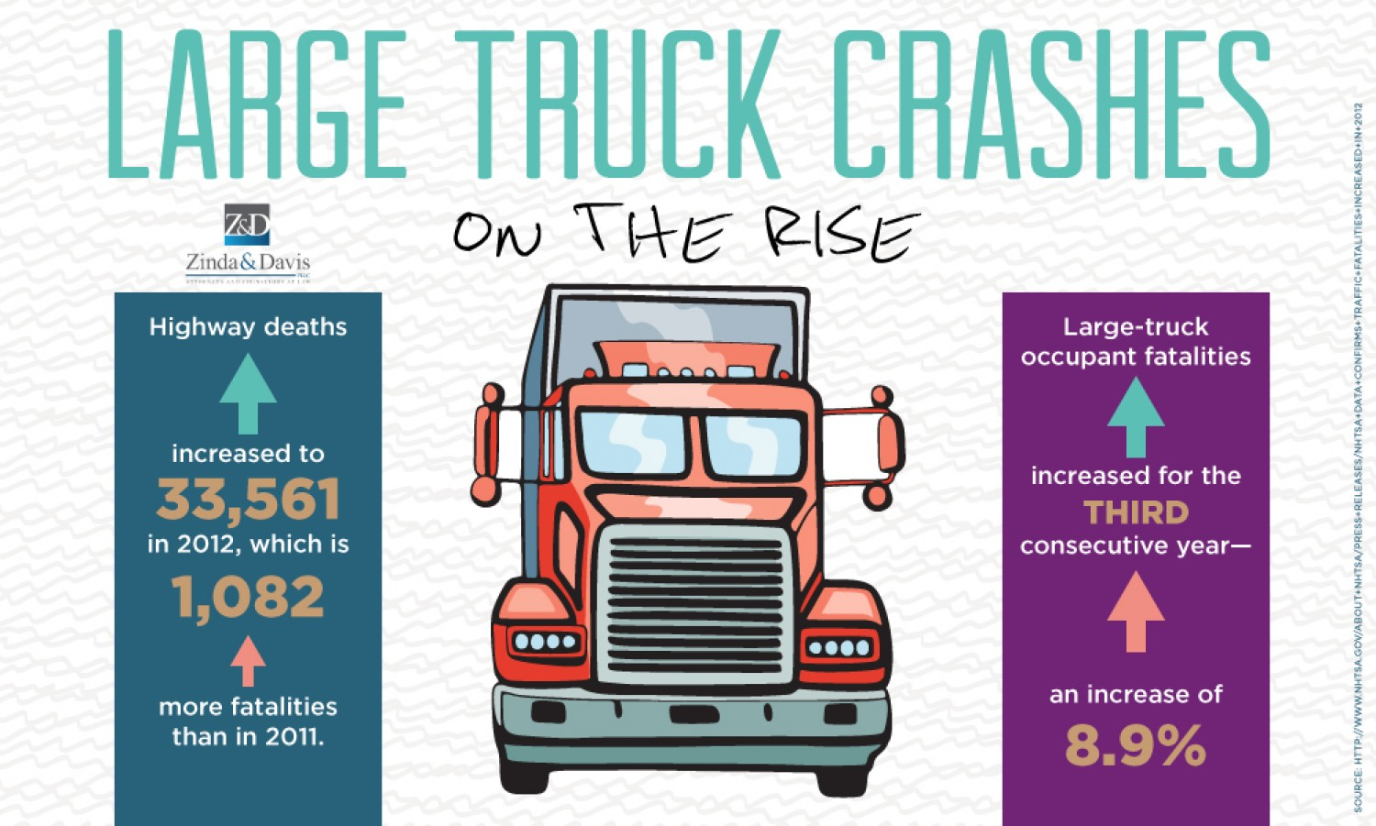

Slide 7
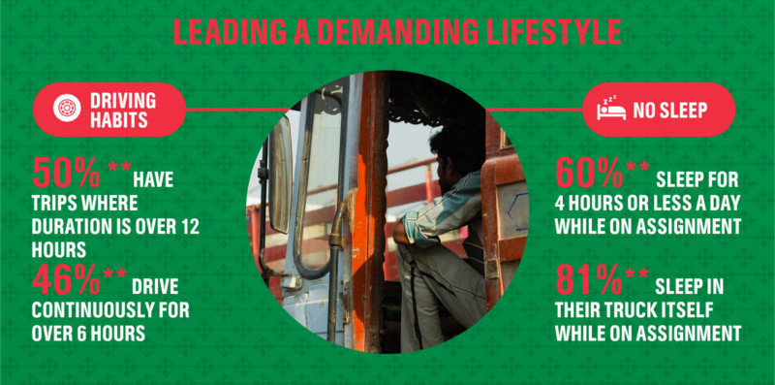

Slide 8
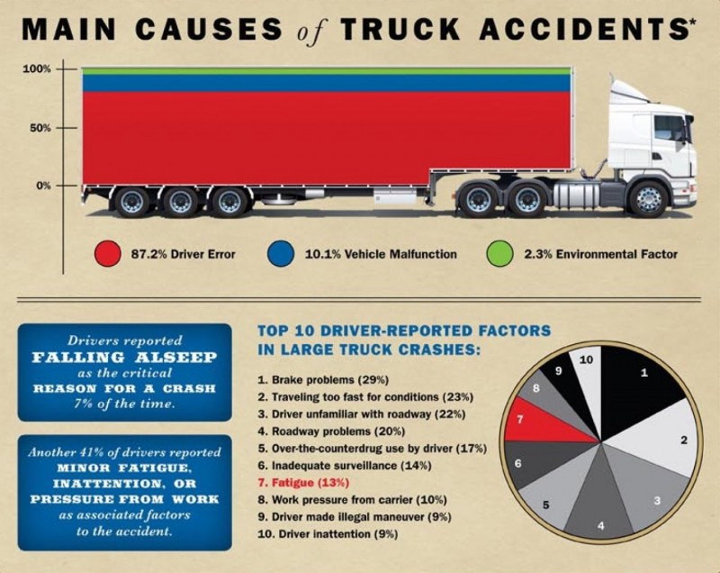

Slide 9
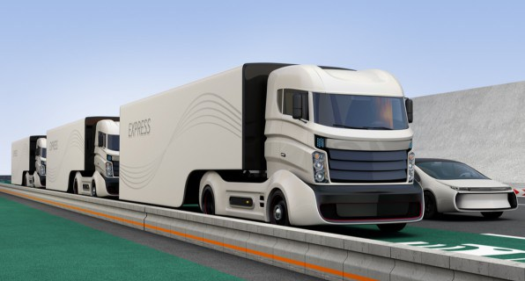
Master Slave Approach in Trucks:

